Slide 1
ALGORITHM AND FLOWCHART
EPROG
COMPUTER FUNDAMENTALS & PROGRAMMING FOR ENGINEERING STUDENTS

Slide 2
Computer Program
A computer program (also a software program, or just a program) is a sequence of instructions written to perform a specified task for a computer. A computer requires programs to function, typically executing the program's instructions in a central processor. The program has an executable form that the computer can use directly to execute the instructions.

Slide 3
Source Code
Source code is text written in a computer programming language. Such a language is specially designed to facilitate the work of computer programmers, who specify the actions to be performed by a computer mostly by writing source code, which can then be automatically translated to binary machine code that the computer can directly read and execute.

Slide 4
Computer Programming
Computer programming (often shortened to programming or coding) is the process of designing, writing, testing, debugging/ troubleshooting, and maintaining the source code of computer programs. This source code is written in a programming language. The purpose of programming is to create a program that exhibits a certain desired behavior. The process of writing source code often requires expertise in many different subjects, including knowledge of the application domain, specialized algorithms and formal logic.

Slide 5
Introduction to Programming
Program: self-contained set of instructions used to operate a computer to produce a specific result
  Also called software
Programming: the process of writing a program, or software

Slide 6
Machine Language
Machine language programs, also called executables, consist of binary instructions
Each instruction has two parts:
  Instruction part: the operation to be performed; also called an opcode
  Address part: memory address of the data to be used
Each class of computer has its own particular machine language
Writing in machine language is tedious!

Slide 7
Assembly Languages
Assembly Language: programming language with symbolic names for opcodes, and decimals or labels for memory addresses
Example:
  ADD 1, 2
  MUL 2, 3
Assembly language programs must be translated into machine instructions, using an assembler

Slide 8

Introduction to Programming: Assembly Language (continued)

Slide 9
Introduction to Programming:
Low-level languages: languages that use instructions tied directly to one type of computer
Examples: machine language, assembly language
High-level languages: instructions resemble written languages, such as English,and can be run on a variety of computer types
Examples: Visual Basic, C, C++, Java

Slide 10
Introduction to Programming: (continued)
Source code: the programs written in a high- or low-level language
Source code must be translated to machine instructions in one of two ways:
  Interpreter: each statement is translated individually and executed immediately after translation
  Compiler: all statements are translated and stored as an executable program, or object program; execution occurs later

Slide 11
Low- and High-Level Languages (continued)
Large C++ programs may be stored in two or more separate program files due to
  Use of previously written code
  Use of code provided by the compiler
  Modular design of the program (for reusability of components)
Linker: combines all of the compiled code required for the program

Slide 12
Low- and High-Level Languages (continued)
Programs can also be classified by their orientation:
  Procedural: available instructions are used to create self-contained units called procedures
  Object-oriented: reusable objects, containing code and data, are manipulated
Object-oriented languages support reusing existing code more easily

Slide 13
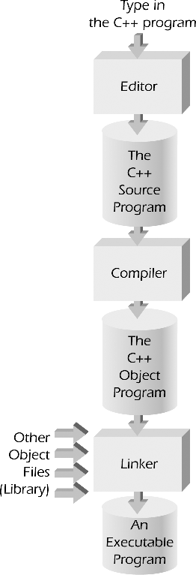
Procedural and Object Orientations
Figure 1.2 Creating an executable C++ program.

Slide 14
Program Development Cycle
1. Analyze: Define the problem
2. Design: Plan the solution to the problem
3. Choose the Interface: Select the objects
4. Code: Translate the algorithm into a programming language.
5. Debug and Test: Locate and remove any errors in the program.
6. Complete the Documentation: Organize all the materials that describe the program.

Slide 15
Algorithms
Algorithm: the step-by-step sequence of instructions that describe how the data is to be processed to produce the desired output
Programming = the translation of the selected algorithm into a language the computer can use

Slide 16
Algorithms (continued)
Pseudocode: English-like phrases used to describe the algorithm
Formula: description of a mathematical equation
Flowchart: diagram showing the flow of instructions in an algorithm
  Flowcharts use special symbols

Slide 17
Expressing Algorithms
Algorithms can be expressed in many kinds of notation, including:
Natural Languages
Pseudocode
Flowcharts
Programming Languages

Slide 18
Pseudocode
A program design technique that uses English words.
Has no formal syntactical rules.
Pseudo means false, thus pseudocode means false code. It looks like (imitates) real code but it is NOT real code.
Pseudocode cannot be compiled nor executed, and there are no real formatting or syntax rules.
Pseudocode should not include keywords in any specific computer languages.
The benefit of pseudocode is that it enables the programmer to concentrate on the algorithms without worrying about all the syntactic details of a particular programming language.

Slide 19
How do I write Pseudocode?
First you may want to make a list of the main tasks that must
be accomplished on a piece of scratch paper.
Then, focus on each of those tasks. Generally, you should try
to break each main task down into very small tasks that can
each be explained with a short phrase.
There may eventually be a one-to-one correlation between
the lines of pseudocode and the lines of the code that you
write after you have finished pseudocoding.

Slide 20
It is not necessary in pseudocode to mention the need to
declare variables. It is wise however to show the initialization
of variables.
All statements showing "dependency" are to be indented.
These include while, do, for, if, switch.
Some Keywords That Should be Used
For looping and selection, the keywords that are to be used include:
Do While...EndDo Call ... with (parameters)
Do Until...Enddo Call
Case...EndCase Return
If...Endif When

Slide 21
As verbs, use the words:
Generate, Compute, Process
Set, Reset, Increment, Compute, Test
Calculate, Add, Sum, Multiply, ...
Print, Display, Input, Output, Edit

Slide 22
Pseudocode Examples
Original Program Specification:
Write a program that obtains two integer numbers from the user. It will print out the sum of those numbers.
Pseudocode:
Prompt the user to enter the first integer
Prompt the user to enter a second integer
Compute the sum of the two user inputs
Display an output prompt that explains the answer as the sum
Display the result

Slide 23
Original Program Specification:
Write a program that will display if the entered student’s grade is passed of failed. Passing grade is 70.
Pseudocode:
Prompt the user to enter a student grade
If student's grade is greater than or equal to 70
Print "passed"
else
Print "failed"

Slide 24
Original Program Specification:
Write a program that will allow the student to input the grade on his 5 subjects and will compute for his average grade.
Original Program Specification:
Set total to zero
Set grade counter to one
While grade counter is less than or equal to 5
Input the next grade
Add the grade into the total
Set the class average to the total divided by 5
Print the class average.

Slide 25
Pseudocode example : If then Else
If age > 17
Display a message indicating you can vote.
Else
Display a message indicating you can't vote.
Endif
Pseudocode example : Case
Case of age
0 to 17 Display "You can't vote."
18 to 64 Display "Your in your working years."
65 + Display "You should be retired."
Endcase

Slide 26
Pseudocode example : While loop
count assigned zero
While count < 5
Display "I love computers!"
Increment count
Endwhile
Pseudocode example : For loop
For x starts at 0, x < 5, increment x
Display "Are we having fun?"
Endfor

Slide 27
Pseudocode example : Do While loop
count assigned five
Do
Display "Blast off is soon!"
Decrement count
While count > zero
Pseudocode example : Repeat Until loop
count assigned five
Repeat
Display "Blast off is soon!"
Decrement count
Until count < one

Slide 28
Pseudocode example : Function with no parameter passing
Function clear monitor
Pass In: nothing
Direct the operating system to clear the monitor Pass Out: nothing
Endfunction
Pseudocode example : Function with parameter passing
Function delay program so you can see the monitor
Pass In: integer representing tenths of a second Using the operating system delay the program
Pass Out: nothing
Endfunction

Slide 29
Pseudocode of : Function main calling the clear monitor function
Function main
Pass In: nothing
Doing some lines of code
Call: clear monitor
Doing some lines of code
Pass Out: value zero to the operating system Endfunction

Slide 30





Flowcharts Symbols

Slide 31
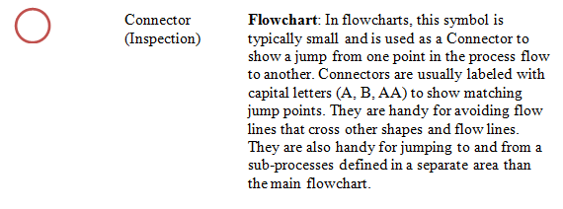
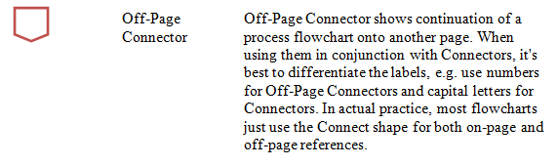
Flowcharts Symbols (continued)

Slide 32
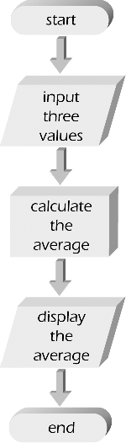
Flowcharts (continued)
Flowchart for calculating the average of three numbers.

Slide 33
Guidelines for Drawing a Flowchart
In drawing a proper flowchart, all necessary requirements
should be listed out in logical order.
The flowchart should be clear, neat and easy to follow. There
should not be any room for ambiguity in understanding the
flowchart.
The usual direction of the flow of a procedure or system is
from left to right or top to bottom.

Slide 34


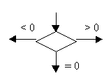
Only one flow line should come out from a process symbol.
Only one flow line should enter a decision symbol, but two or
three flow lines, one for each possible answer, should leave the
decision symbol.

Slide 35
If the flowchart becomes complex, it is better to use
connector symbols to reduce the number of flow lines.
Avoid the intersection of flow lines if you want to make it
more effective and better way of communication.
Ensure that the flowchart has a logical start and finish.
It is useful to test the validity of the flowchart by passing
through it with a simple test data.

Slide 36
Advantages of using flowcharts
The benefits of flowcharts are as follows:
Communication: Flowcharts are better way of communicating
the logic of a system to all concerned.
Effective analysis: With the help of flowchart, problem can be
analyzed in more effective way.
Proper documentation: Program flowcharts serve as a good
program documentation, which is needed for various purposes.

Slide 37
Efficient Coding: The flowcharts act as a guide or blueprint during the systems analysis and program development phase.
Proper Debugging: The flowchart helps in debugging process.
Efficient Program Maintenance: The maintenance of operating
program becomes easy with the help of flowchart. It helps the
programmer to put efforts more efficiently on that part

Slide 38
Limitations of using flowcharts
Complex logic: Sometimes, the program logic is quite
complicated. In that case, flowchart becomes complex and
clumsy.
Alterations and Modifications: If alterations are required the
flowchart may require re-drawing completely.
Reproduction: As the flowchart symbols cannot be typed,
reproduction of flowchart becomes a problem.

Slide 39
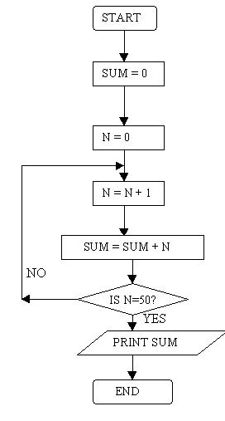
Flowcharting Examples
Example 1
Draw a flowchart to find the sum of first 50 natural numbers.

Slide 40
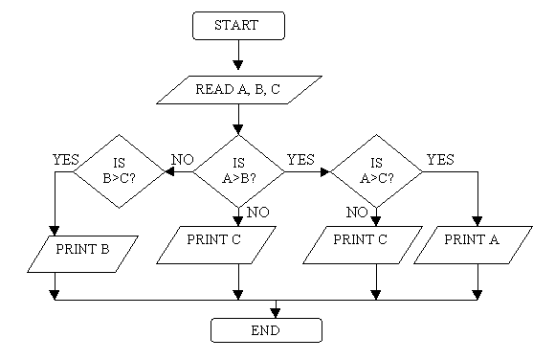
Example 2
Draw a flowchart to find the largest of three numbers A,B, and C.

Slide 41
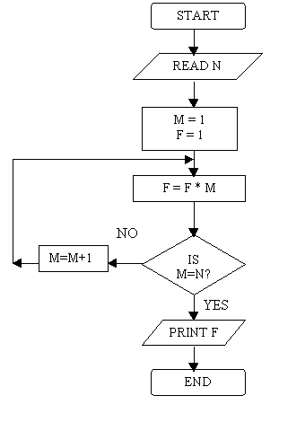
Example 3
Draw a flowchart for computing factorial N (N!)
Where N! = 1 ´ 2 ´ 3 ´ …… N .

Slide 42
Problem Solving Process
Input
Process
Output

Slide 43
Example Problem #1
Calculate and display the price of a number of apples if the quantity in kg and price per kg are given.
Input
Process
Output
Quantity
Price_per_kg
Price = Quantity * Price_per_kg
Price

Slide 44



Pseudocode
Start
Read quantity
Read price_per_kg
price ← quantity * price_per_kg
Print price
End

Slide 45
Flowchart: Calculate Price of Apples
Start
Input
Quantity
Input
Price_per_kg
Price = Quantity * Price_per_kg
Output
Price
End

Slide 46
Source Code
#include<stdio.h>
#include<iostream>
using namespace std;
#define p printf
#define s scanf
int main()
{
float price = 0; int quantity = 0;
float price_per_kg = 0;
p("Enter quantity of an apple : “) ;
s(“%d”, &quantity);
p("Enter price of an apple per kilogram : " );
s(“%f”, &price_per_kg);
price = quantity * price_per_kg;
p("The price of an apple in kilogram is %.2f“, price);
system ("pause>0");
}
Pre-processor
Main function
Start
Variable declarations
Input
Input
computations
Output
Stop
Notes:
#include <iostream>

Slide 47
Thank you!

